Slide 1
Group 10
ATUL KUMAR – IIT2018030
RAUSHAN RAJ – IIT2018031

Slide 2
> This Algorithm inspects Armstrong number in the range of 0 and 999 . > An Armstrong number is a number such that the sum of its digits raised to the power of no. of digit is equal to the number itself. For example, 371 is an Armstrong number. > since 3**3 + 7**3 + 1**3 = 371.
INTRODUCTION

Slide 3
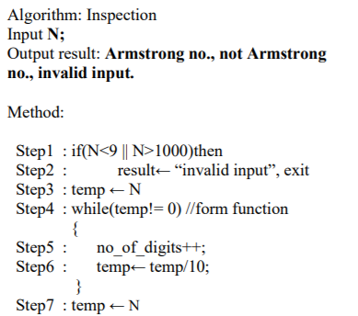
> > In our algorithm after input of no. N we check validity of N and the no. of digit in no. n. > by passing N to function form we get no. of digits. >after getting the no. of digit we store N to a temp variable.
ALGORITHM

Slide 4
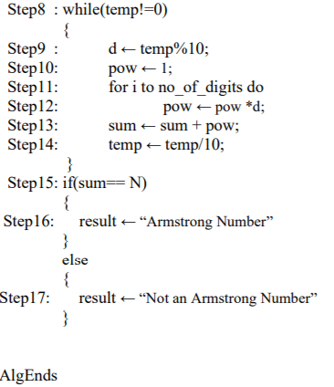
.>After storing n to temp we perform operation on temp to check inspection of Armstrong no. N. > we do the sum of digits of no. N raised to the power of no. of digits we calculated previous . >if sum equals N then no. is Armstrong NO. else not Armstrong.
ALGORITHM

Slide 5
EXPERIMENTAL ANALYSIS

Slide 6
THE ALGORITHM WILL RUN BEST WHEN THE NO. n, INPUT IS A TWO DIGIT no. . >then the algorithm time complexity is best.
THE BEST CASE

Slide 7
Time complexity of algorithm is logarithm: log10(x). > so larger the value of N greater is the time taken to inspect it as an Armstrong. This is shown in graph.
THE WORST CASE

Slide 8
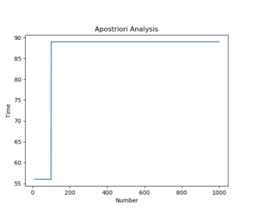
THE GRAPH

Slide 9
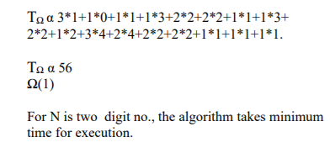
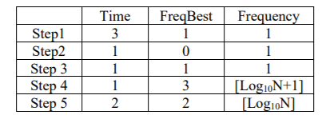
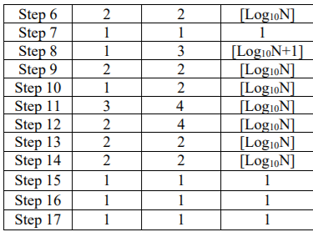
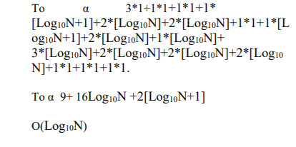
TIME COMPLEXITY
For Best case : - >
N must be a two digit no. like10.
For Worst case : - >
Time complexity for worst case is logarithm: log10(N)

Slide 10
>The algorithm was proven to be best for N to be two digit no. >the complexity is a logarithmic function of time ---O(log10N) .
CONCLUSION

Slide 11
THANK YOU

